Slide 1
Lecture 18: Regulating Cars
Prof. Austin
Environmental Economics Econ 475

Slide 2
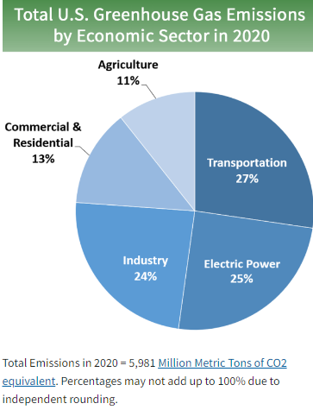
Why Regulate Cars?
Many externalities:
GHG emissions
Other air pollutants (e.g., CO, PM, NOx)
Traffic congestion costs
Accidents and fatalities
Source: EPA (2021).

Slide 3
Some Policy Options
Some options for reducing these externalities:
Fuel Tax: a tax on each unit of fuel purchased.
Fuel Economy Standard: A car must meet a certain miles per gallon standard.
Attribute-based Fuel Economy Standard: Different types of cars must meet different miles per gallon standards.
Emissions Standards: Specific required reductions of tailpipe emissions for all car models.
Others: car property tax, tax on car attributes (engine size, age, weight), car type requirements, new/old car registration fee, etc.

Slide 4
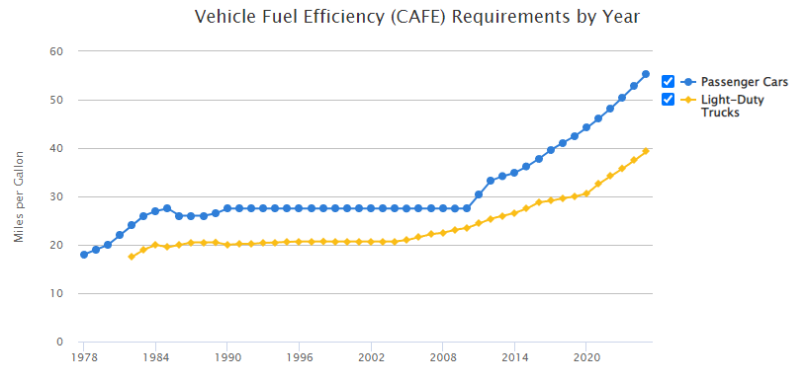
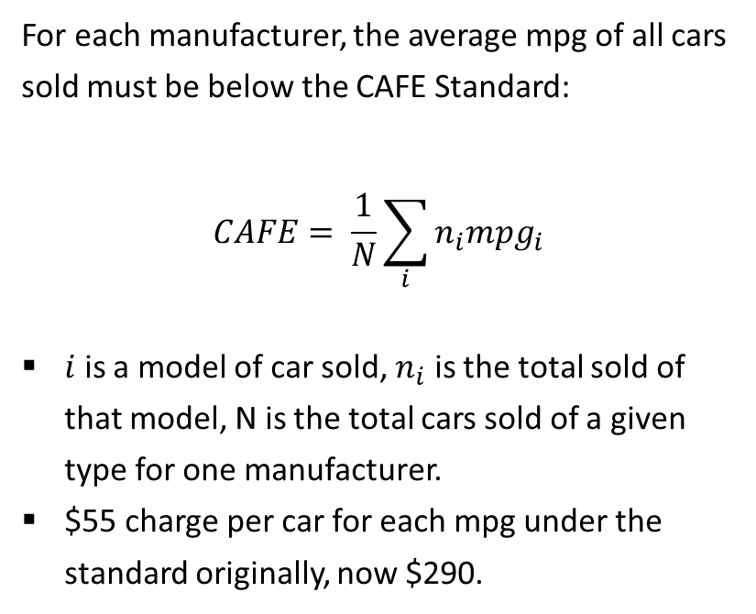
The Corporate Average Fuel Economy Standard
For each manufacturer, the average mpg of all cars sold must be below the CAFE Standard:
$$CAFE= \frac{1}{N}\sum_{i}{n_{i}{mpg}_{i}}$$
$i$ is a model of car sold, $n_{i}$ is the total sold of that model, N is the total cars sold of a given type for one manufacturer.
$55 charge per car for each mpg under the standard originally, now $290.
Source.

Slide 5
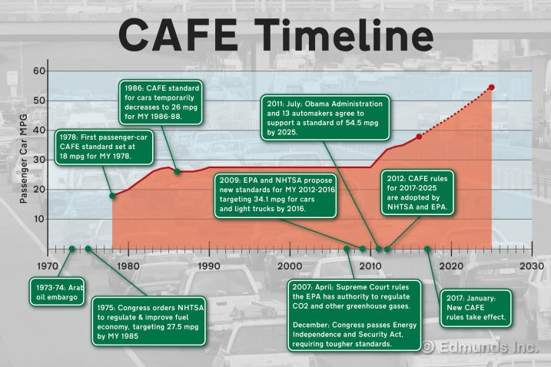

Slide 6
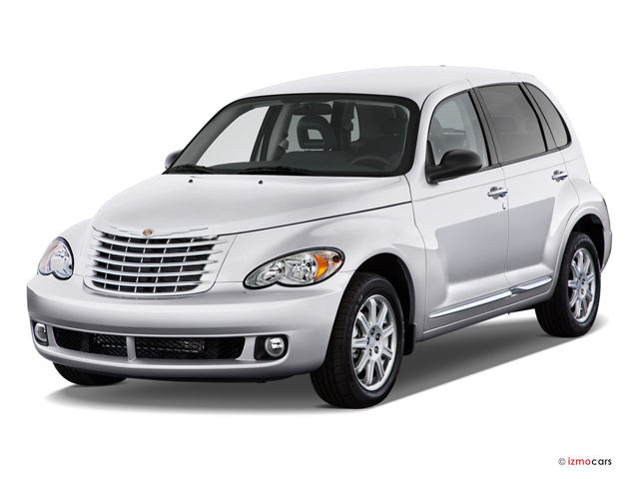
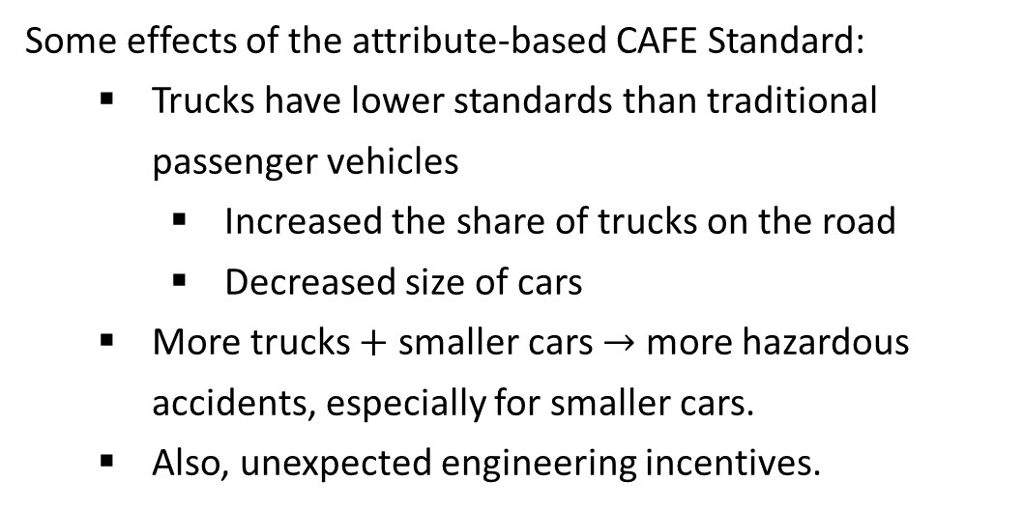
CAFE Standard in Practice
Car or truck?
Some effects of the attribute-based CAFE Standard:
Trucks have lower standards than traditional passenger vehicles
Increased the share of trucks on the road
Decreased size of cars
More trucks $+$ smaller cars $→$ more hazardous accidents, especially for smaller cars.
Also, unexpected engineering incentives.
The PT cruiser was engineered to meet design classifications of a light truck to lower Chrysler’s light truck AFE.

Slide 7
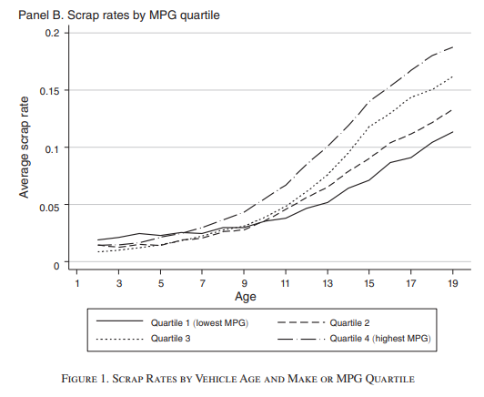
More on CAFE in Practice
Also, the Gruenspecht effect:
AFE standards decrease relative sale prices of new high fuel economy cars vs. new low fuel economy cars (Bento et al., 2020).
New high fuel economy cars are relatively cheaper in relation to used ones, hence scrapped sooner
New low-fuel economy cars are relatively more expensive in relation to used ones, hence scrapped later
Source: Jacobsen and Benthem (2015).

Slide 8
Even More on CAFE in Practice
A CAFE standard does not directly impact the activity that leads to many externalities associated with driving cars:
No incentive to reduce driving. Actually, incentive to increase driving (the Rebound Effect).
More congestion, air pollution, and traffic fatalities.
Carmakers may meet AFE targets with engine changes that can increase emissions of air pollutants other than carbon dioxide.
Shift to gasoline direct injection (GDI) engines increases emissions of particulate matter (Neyestani, 2020).

Slide 9
Why CAFE?
Q: Given these potentially unintended consequences, why implement attribute-based fuel economy standards?
One answer: The primary motivation for AFE standards was energy independence.
Another answer: Consumers systematically mis-judge the vehicle-specific lifetime cost of fuel when purchasing a vehicle because they have MPG illusion.

Slide 10
MPG Illusion
Suppose you drive 10,000 miles per year (about average). Which improvement in
fuel economy is best?
From 10 to 11 mpg
From 17 to 20 mpg
From 35 to 50 mpg
http://www.mpgillusion.com/p/what-is-mpg-illusion.html

Slide 11
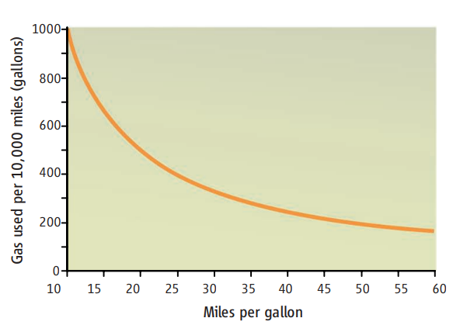

MPG Illusion
$$gpm=\frac{1}{mpg}$$
Miles per gallon is a useful metric for:
How far you can go with one gallon
Range of your tank
What is most useful in making a fuel economy consumer decision?
How much gas you’ll use given your driving habits, or gallons per mile.
Related, how much you’ll spend on gas.
The latter is also more useful for considering the GHG implications. One gallon is 20 pounds of CO2.
http://www.mpgillusion.com/p/what-is-mpg-illusion.html

Slide 12
MPG Illusion
Miles Per Gallon | Gallons Per 100 Miles | Gallons Per 10,000 Miles
10.0 | 10 | 1000
11.0 | 9 | 900
12.5 | 8 | 800
14.0 | 7 | 700
16.5 | 6 | 600
20.0 | 5 | 500
25.0 | 4 | 400
33.0 | 3 | 300
50.0 | 2 | 200
Table displays MPG improvements that yield equal decreases in gas consumption
Gas savings are not a linear function of MPG.
Gallons per mile is a more intuitive way of thinking about fuel economy
http://www.mpgillusion.com/p/what-is-mpg-illusion.html

Slide 13
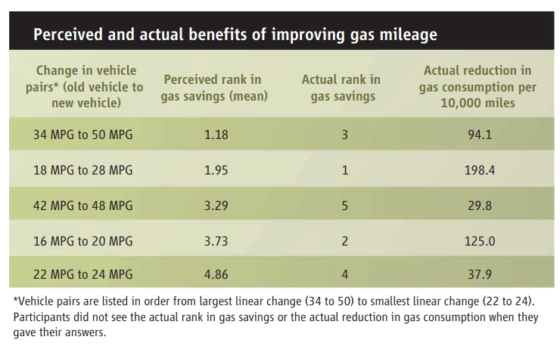
Larrick & Soll, 2008
Consumers do systematically mis-judge fuel economy savings.
Can be improved dramatically by re-framing in terms of GPM and providing this information to consumers.

Slide 14
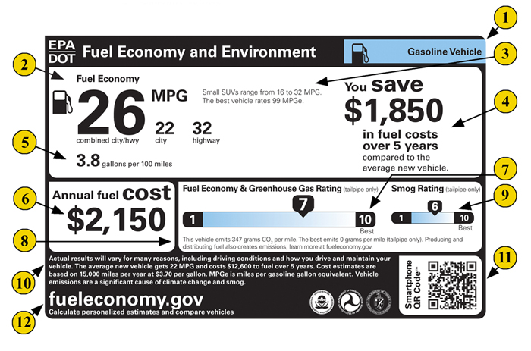
Solving MPG Illusion
http://www.mpgillusion.com/p/what-is-mpg-illusion.html

Slide 15
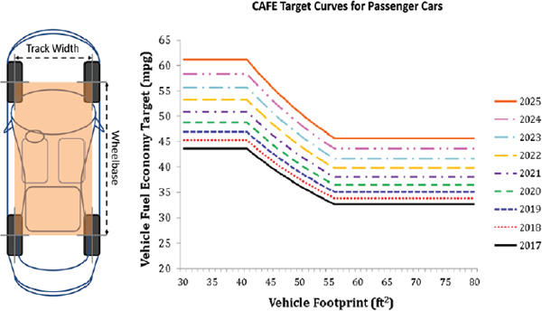
CAFE after 2011
The CAFE standards were modified after 2011.
Allowed trading of MPG allowances across firms.
New fuel standard depending on footprint of the vehicle.
Continuous increases in AFE standard by footprint over time.
Footprint (sq feet)
Source.

Slide 16
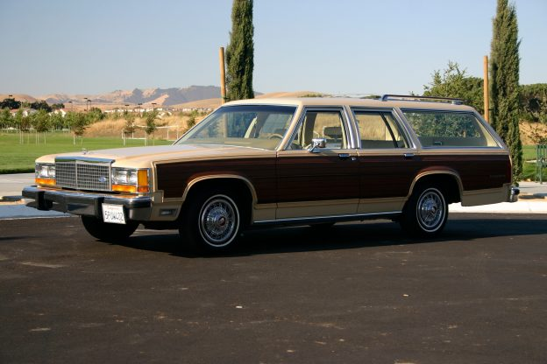
CAFE after 2011: Increased Vehicle Size
One motivation for footprint-based standards was to improve safety. Carmakers no longer had a strong incentive to decrease car size to achieve AFE standards.
Actual effect:
Cars became larger within type (Jean, 2015).
Compact trucks and station wagons far less common (link).
Aggregate effect on accident fatality risk?
Image source.

Slide 17
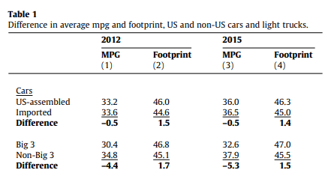
CAFE after 2011: A Tariff?
US-made cars were on average larger and had lower MPG than imported cars.
Imported cars had an easier time meeting a uniform AFE of 33.3 mpg.
Difference in MPG of -0.5 is roughly $28 disadvantage per car for US carmakers.
For big three US auto-makers (GM, Ford, Chrysler), difference of -4.4 is a $242 disadvantage per car.
Source: Levinson (2017)

Slide 18
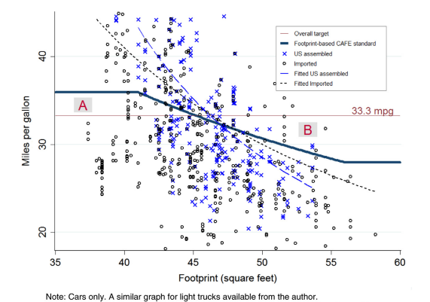
CAFE after 2011: A Tariff?
Fail a new footprint based AFE, but pass a uniform AFE.
Pass a new footprint based AFE, but fail a uniform AFE.
Source: Levinson (2017)

Slide 19
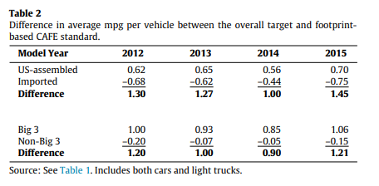
CAFE after 2011: A Tariff?
Switch to footprint-based standards meant US-made cars were on average 0.62 above the new AFE, while imported cars were -0.68 below it.
With fine of $55 per mpg difference, this is a $72 advantage per car.
With trading of allotments, this meant US carmakers could also sell their new footprint advantage to foreign carmakers.
Source: Levinson (2017)

Slide 20
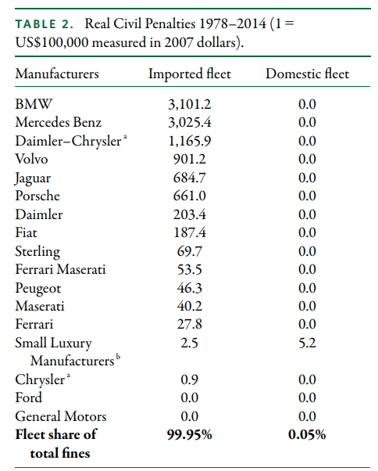
CAFE after 2011: A Tariff?
Source: Levinson (2017)

Slide 21
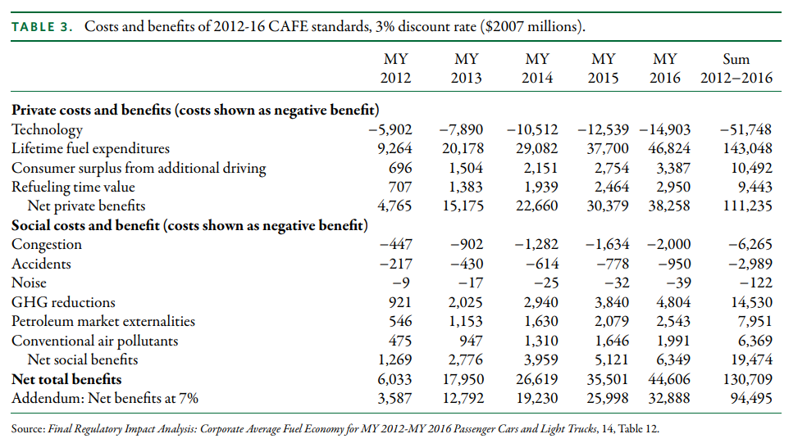
CAFE: Overall Costs and Benefits
Still, large net benefits of new CAFE standards.
What about alternative policy designs?
Source: Levinson (2017)

Slide 22
Fullerton and West (2000)
Research Question: What combination of taxes or subsidies on cars maximizes consumer welfare?
Methods:
Consumer utility model parameterized with real data from 1261 individuals/cars.
Simulate alternative combinations of taxes.
No tax
Ideal Pigouvian tax on externalities
Combination of gas, engine size, and vehicle age taxes.
Calculate welfare improvements.

Slide 23
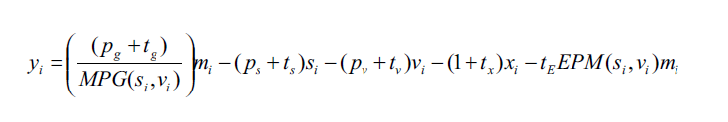
Fullerton and West (2000)
Consumer utility model:
Consumer maximizes utility:
Subject to budget constraint:

Slide 24
Fullerton and West (2000)
Engine size (s)
Car vintage (v)
Consumer utility model:
Consumer maximizes utility:
Subject to budget constraint:
Other goods
External damages
VMT (m)

Slide 25
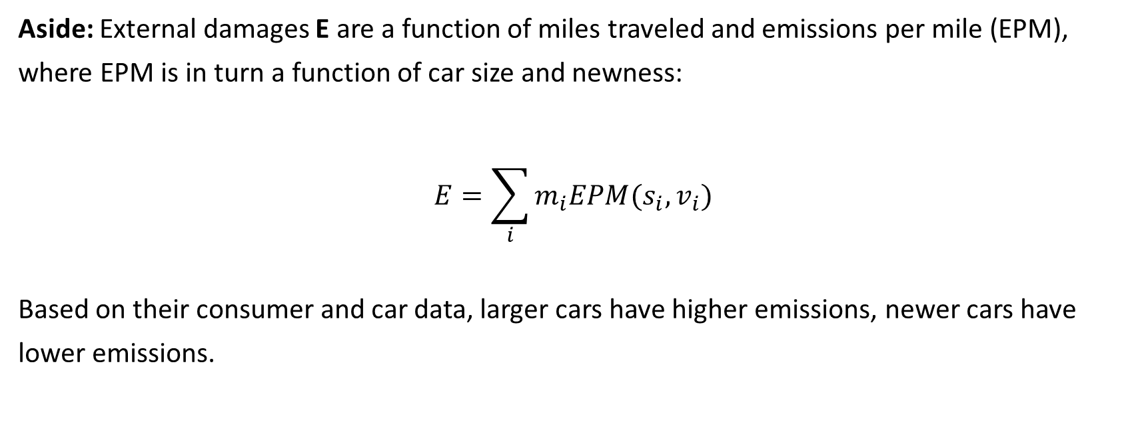
Fullerton and West (2000)
Aside: External damages E are a function of miles traveled and emissions per mile (EPM), where EPM is in turn a function of car size and newness:
$$E=\sum_{i}{m_{i}EPM(s_{i},v_{i})}$$
Based on their consumer and car data, larger cars have higher emissions, newer cars have lower emissions.

Slide 26
Fullerton and West (2000)
Consumer utility model:
Consumer maximizes utility:
Subject to budget constraint:
Gas tax
Size tax
Vintage tax
Ideal emissions tax
Income

Slide 27
Fullerton and West (2000)
Parameterize the model using 1261 consumer and vehicle data points:
Gasoline and car expenditures from 1994 Consumer Expenditure Survey
California Air Resource Board surveillance program data on air emissions per car, VMT

Slide 28
Fullerton and West (2000)
Results:
1) 71% of the welfare gains from the first-best Pigouvian can be achieved with a three-part tax.

Slide 29
Fullerton and West (2000)
Results:
2) 62% of the welfare gains from the first-best can be achieved with just a fuel tax.

Slide 30
Fullerton and West (2000)
Results:
3) What’s going on with taxes on size and vintage?
Adding car size or increasing vintage affects fuel efficiency, meaning these individuals already pay more for extra size through gas tax. Optimal tax rebates part of that.

Slide 31
Anderson and Sallee (2016)
To summarize the literature and provide a few key take-aways.
No regulatory alternative achieves the economic efficiency of a fuel tax.
Biases in consumer choice are not strong enough to overturn the finding that a fuel tax is more efficient than a fuel economy standard.
Attribute-based standards are obtuse instruments for addressing behavioral biases because they preserve existing tradeoffs between fuel economy and other car attributes.

Slide 32
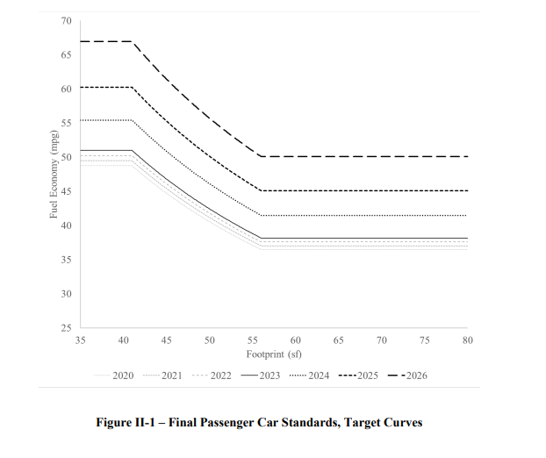
Latest in Average Fuel Economy Standards
New CAFE Footprint-based Standards
Two newer revisions to the rules:
2020 Safer Affordable Fuel-Efficient (SAFE) Vehicles Act
2022 proposed new CAFE is set at higher AFE levels over time.
Each are the same as 2011 CAFE in policy design. EPA and DOT coordinate on similar fuel economy and carbon dioxide standards that increase over time.

Slide 33
Part 2: Vehicle Air Pollution Standards

Slide 34
Regulatory Instruments in CAA
The Clean Air Act allows regulation of mobile sources of pollution. Three general types of regulatory instrument have been used:
Technology-based emissions standards for new vehicles
Examples: catalytic converters
Emissions standards for new vehicles
Fuel content regulations
Examples: leaded gasoline, VOCs, renewable fuel standards

Slide 35
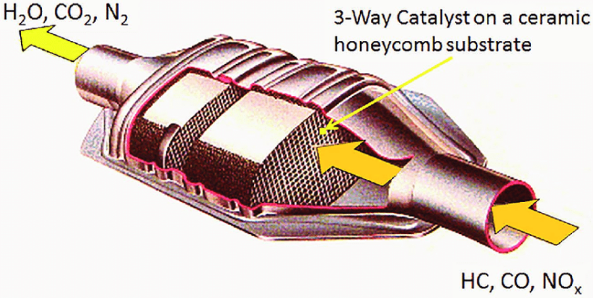
Earliest Emissions Standards
1972 standards for carbon monoxide and NOx in mobile sources essentially required installation of catalytic converters:
Catalytic converters were not economically viable in the 1960s, but rapidly became so after standards.
Composed of precious metals that serve as catalysts in neutralizing air pollutants without altering the metal itself.
Rhodium abates NOx.
Palladium abates CO.
Platinum abates both.
Source.

Slide 36
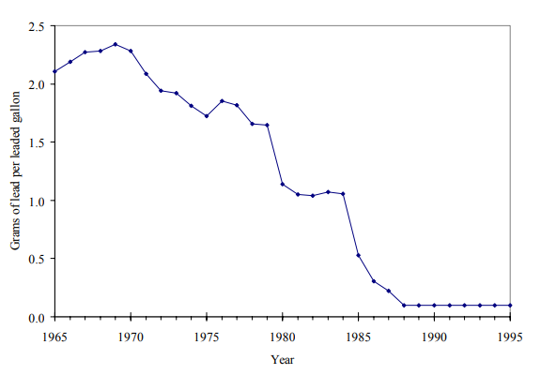
Lead Fuel Content Regulations
Leaded gas fully banned in cars
Market-based phasedown
Lead coats the metals in a CC, decreasing its efficacy over time.
In 1975, new vehicles required to use unleaded gasoline (fuel content regulation)
Smaller refineries couldn’t abate lead from their fuel at competitive costs.
Market-based lead phasedown allowed firms to reduce lead by under the legal limit and sell the difference as credits to other refiners or bank them for later.
Lead phase-down (1982-1987) took place faster than expected and generated 20% savings compared to uniform limit.
Source: Newell and Rogers, 2003

Slide 37
Evolution of Exhaust Standards
Car exhaust standards for specific criteria air pollutants have dramatically lowered these emissions over time.
Few incentives to reduce tailpipe emissions for manufacturers, and consumers are generally not aware of pollution composition of emissions.
Increasing standards over time explains ~99% of the reductions in tailpipe emissions for criteria pollutants (Jacobsen, Sallee, Shapiro, and Benthem, 2022).
Roughly 16 percent of all vehicles sold (80 million), had recalls for failing emissions standards from 1975-2008.

Slide 38
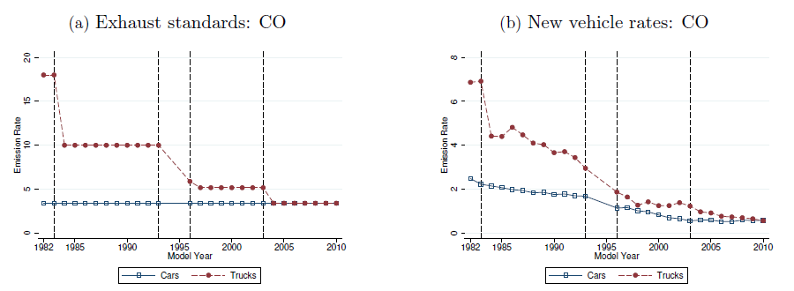
Evolution of Exhaust Standards: CO
Note the y axis is not the same scale across figures
Source: Jacobsen, Sallee, Shapiro, and Benthem (2022).

Slide 39
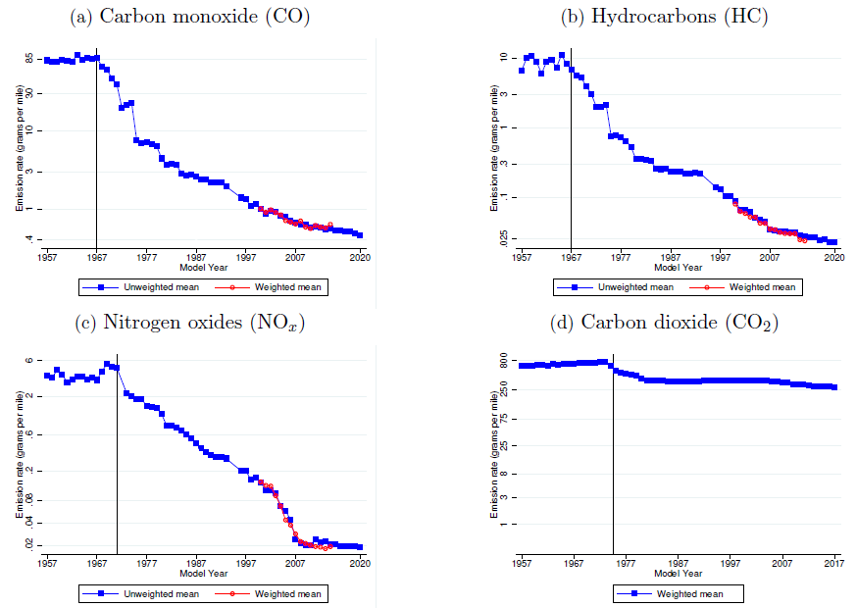
Evolution of Car Emission Rates of New Vehicles
Source: Jacobsen, Sallee, Shapiro, and Benthem (2022).

Slide 40
Pitfalls of Tailpipe Emissions Standards
Two concerns over time:
New car standards increase prices of new cars relative to older cars.
Gruenspecht effect: dirty cars are kept for longer, hence more air pollution.
Cheating on emissions tests: Automakers have incentives to engage in various types of cheating behaviors.
Volkswagen “defeat devices”: Sold 600,000 cars in US from 2006-2015.
Each released equivalent air pollution of 150 gasoline cars.
Estimated 40,000 additional low birthweight newborns caused by the cheating cars (Alexander and Schwandt, 2022)

Slide 41
Next class
Don’t forget to submit your third case study by Monday’s class!
On Monday we will start by going over your case study and then play a review game for the Midterm.

